Slide 1
《群書治要》：
構建人類命運共同體的智慧指南
劉 余 莉

Slide 2
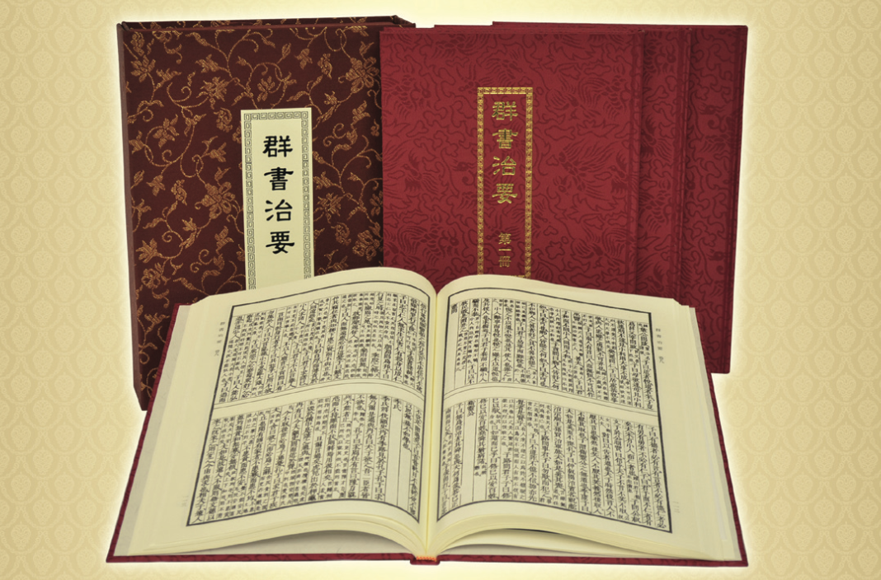

Slide 3
人類的生存沒有比今天更危險的時代了。這種對人類生存的威脅，是人類自己招致的。如果人把自己的技術濫用于利己主義、邪門歪道和罪惡目的，就有致命的危險。正因如此，它才遠比地震、火山爆發、暴風、洪水、乾旱、病毒、細菌，還有鯊魚和猛虎，更加危險。
——湯因比

Slide 4
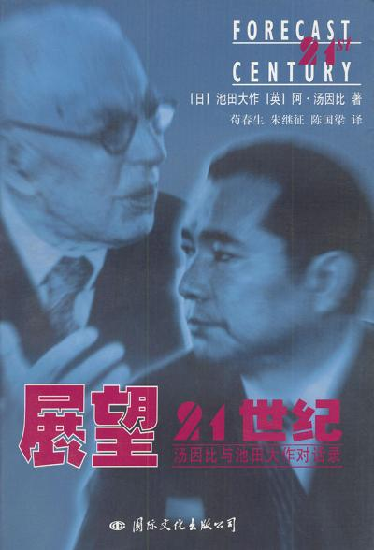
能够真正解决二十一世紀社會問題的，唯有中國的傳統文化。

Slide 5
“構建人類命運共同體”，是習主席解決當今世界各種難題、消弭全球各種亂象的“中國方案”。

Slide 6
2013年3月，習主席在莫斯科國際關係學院發表演講，第一次向世界傳遞了他對人類文明走向的基本判斷：
“這個世界，各國相互聯繫、相互依存的程度空前加深，人類生活在同一個地球村裡，生活在歷史和現實交匯的同一個時空里，越來越成為你中有我、我中有你的命運共同體。”
首次向世界闡述他的“全球觀”。

Slide 7
習主席在2017年12月1日的演講中說：“人類命運共同體，顧名思義，就是每個民族、每個國家的前途命運都緊緊聯繫在一起，應該風雨同舟，榮辱與共，努力把我們生於斯、長於斯的這個星球建成一個和睦的大家庭，把世界各國人民對美好生活的嚮往變成現實。”

Slide 8
《群書治要》的宇宙觀：
一體

Slide 9
Loving and respecting our parents and siblings, are they not fundamental to the actualisation of human goodness?
—— Analects of Confucius
君子務本，本立而道生，孝弟也者，其為仁之本與？
—— 《論語·學而》
Notes:
As the Analects of Confucius stated, ‘Loving and respecting our parents and siblings, are they not fundamental to the actualisation of human goodness?’

Slide 10
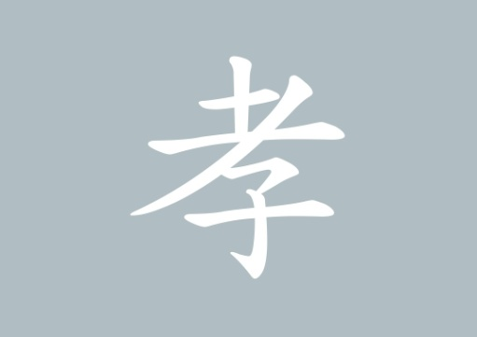
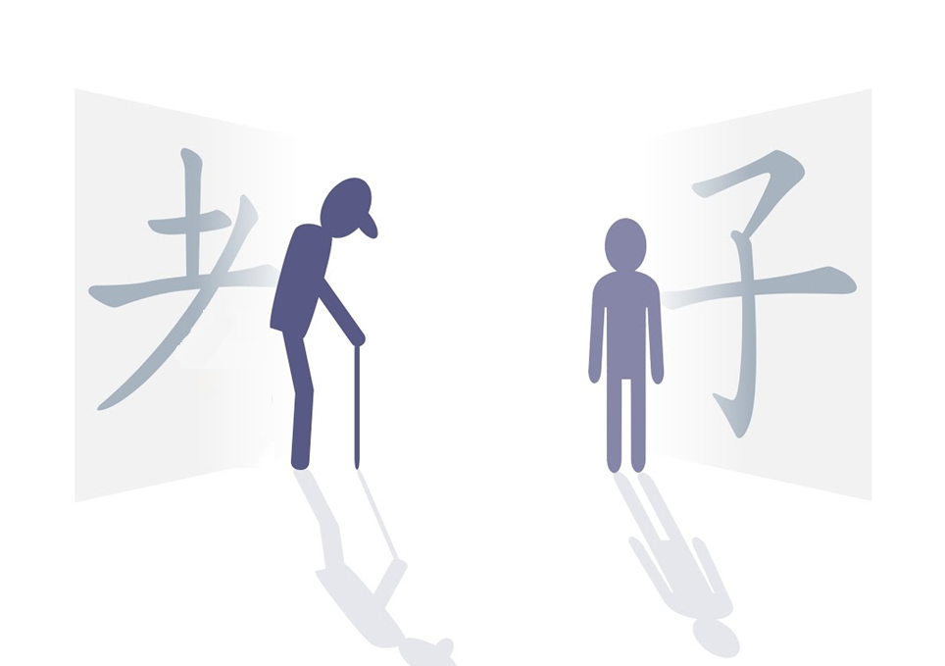
old child
Notes:
Let us take a look at the Chinese character for filial piety (孝). On the top of it, there is an abbreviated form of the character for old (老). At the bottom, there is a character for child (子).

Slide 11
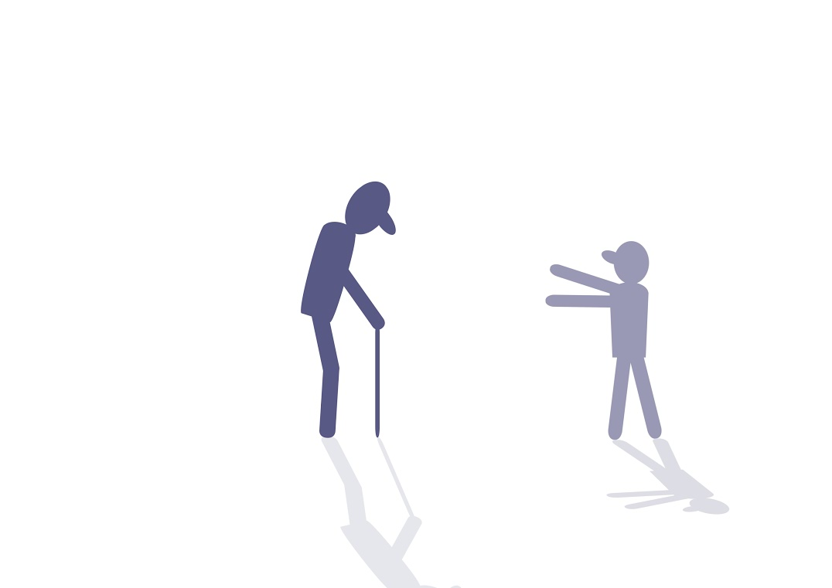
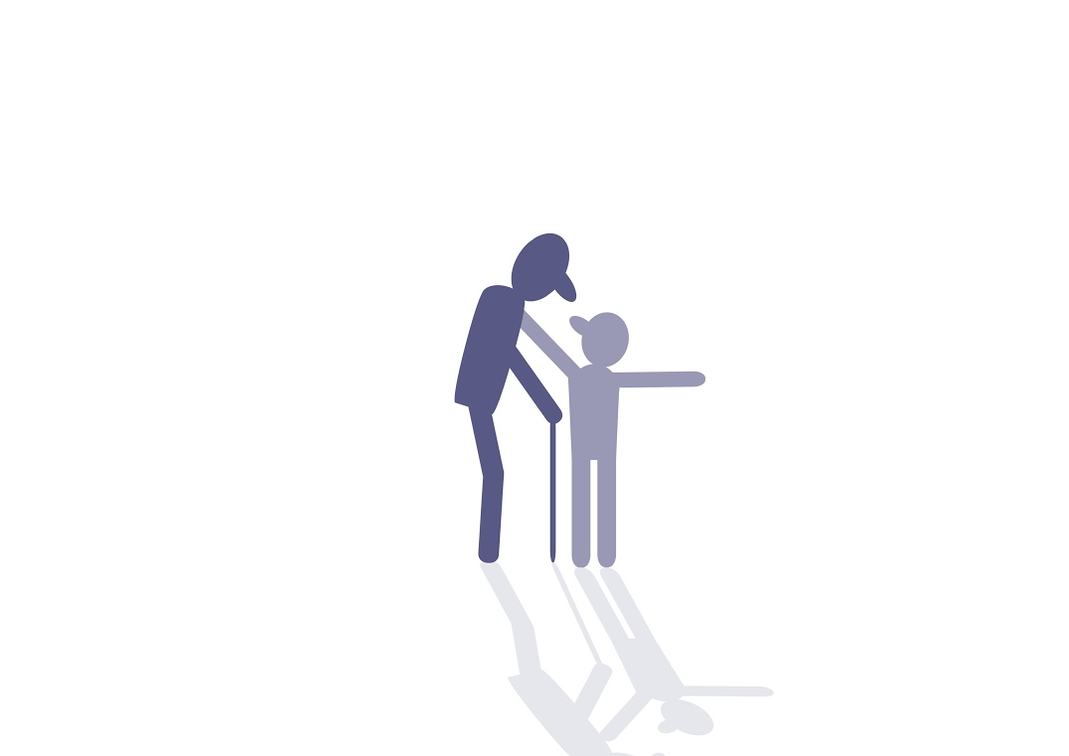
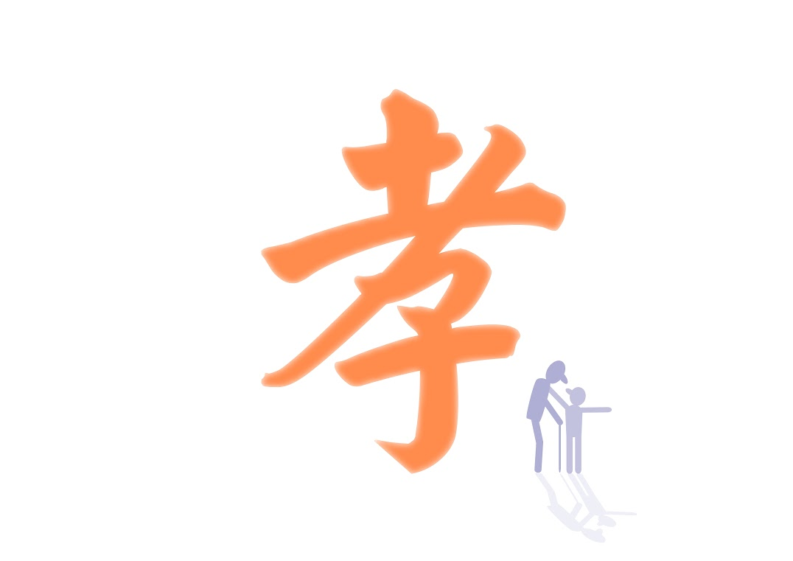
Filial piety
Notes:
When combined, it means that the older generation and the younger generation are one entity. However, there are infinite generations in the past and infinite generations to come.
This character indicates that the different generations are one entity.

Slide 12
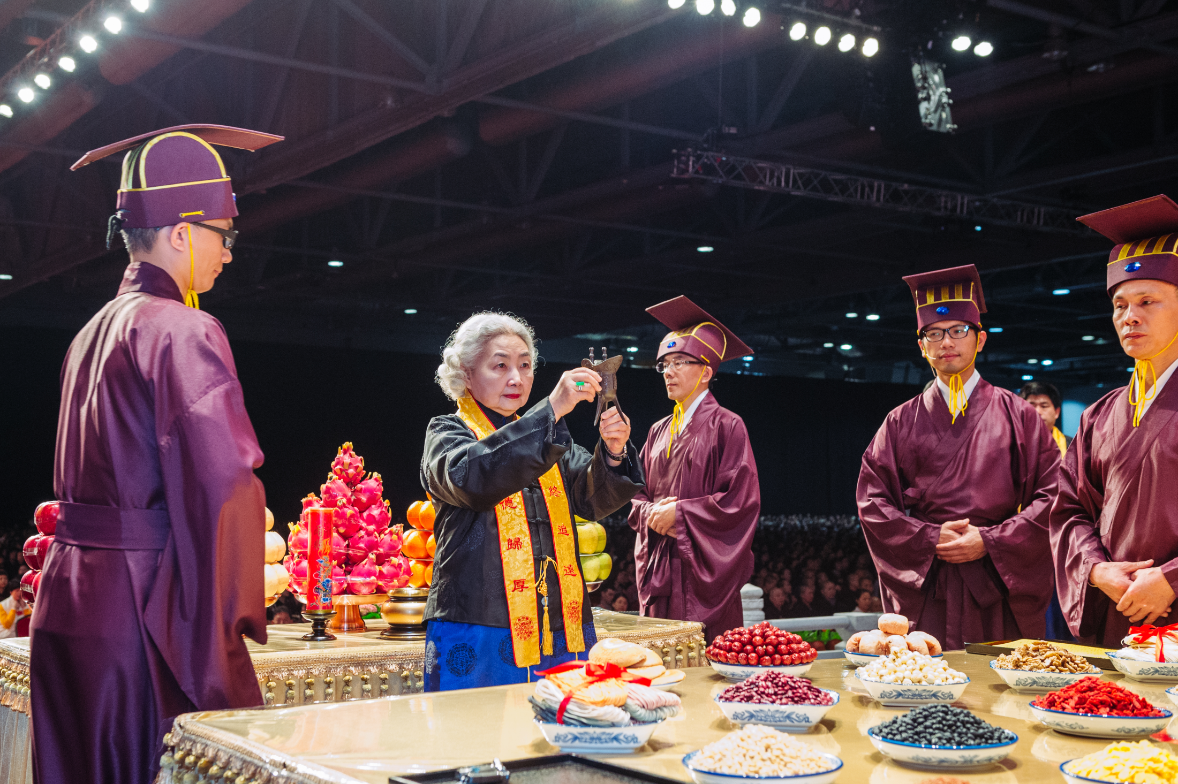
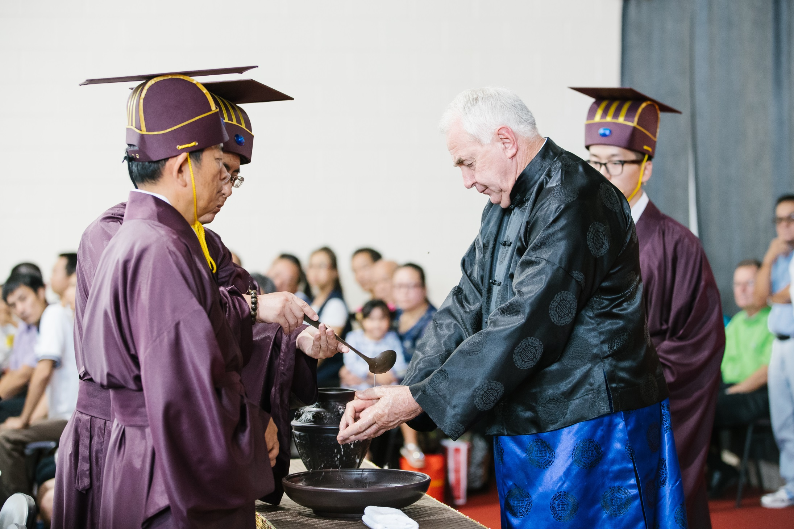
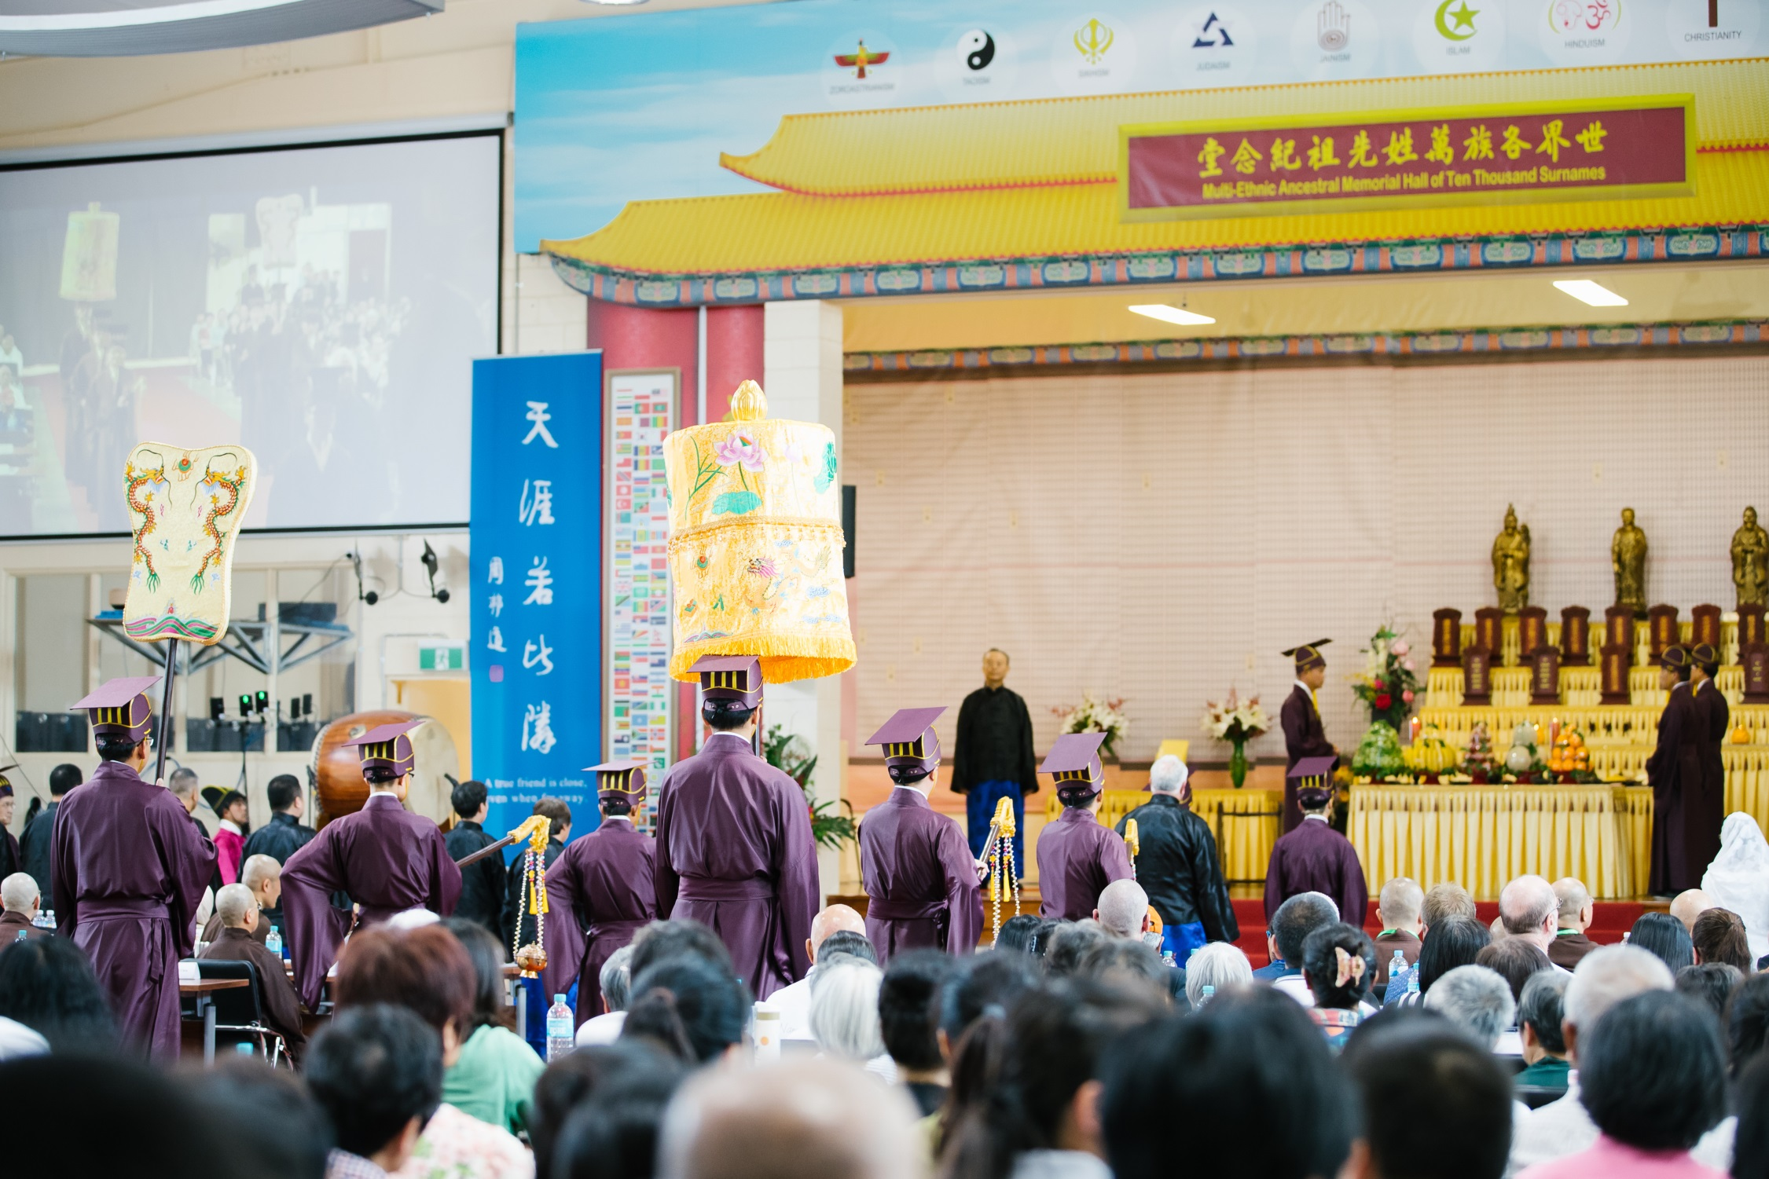
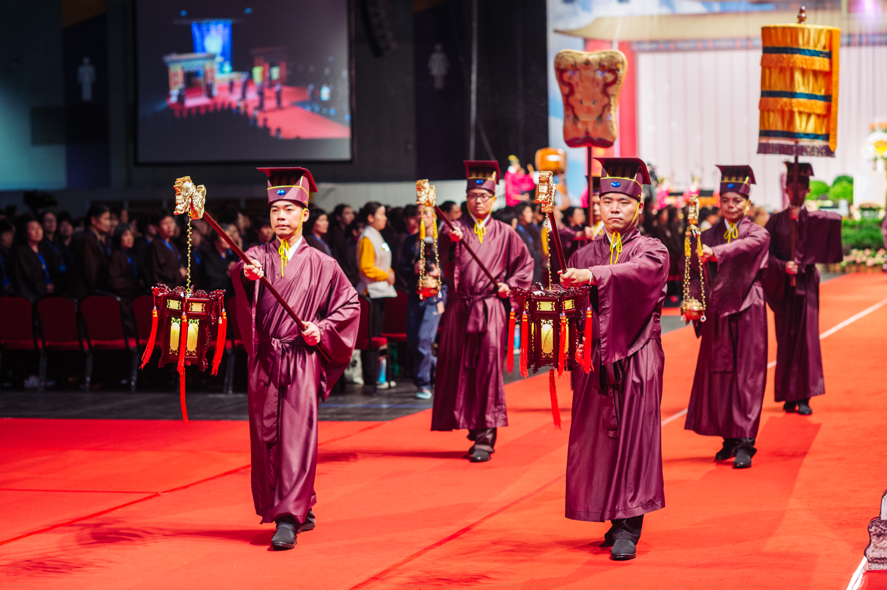
Notes:
That is why the Chinese emphasise the tradition of remembering their ancestors. Some people cannot see the point of doing so. They say, ‘You do not even know your ancestors from several hundred years ago. Why do you still hold remembrance ceremonies for them?’

Slide 13
Let there be careful attention to performing the funeral rites to parents, and let them be commemorated with ancestral remembrance ceremonies. Through this, the people will recover their innate virtue.
—— Analects of Confucius
慎終追遠，民德歸厚矣。
—— 《論語·學而》
Notes:
The Analects of Confucius explains, ‘Let there be careful attention to performing the funeral rites to parents, and let them be commemorated with ancestral remembrance ceremonies. Through this, the people will recover their innate virtue.’ If we can organise our parents’ funerals carefully and remember our ancestors, social customs will naturally become honest.
Why is this? If a person always keeps their ancestors in mind and can commemorate them regularly, how can they possibly not look after their parents? It is unlikely that they would remember their ancestors and disrespect their parents at the same time.
Therefore, commemorating ancestors fosters one’s awareness of kindness of others and develops one’s sense of gratitude.

Slide 14
昭述祖德，傳承家風

Slide 15
All people in the world are our siblings.
—— Analects of Confucius
四海之內，皆兄弟也。
—— 《論語·顏淵》
Notes:
In reference to our elders, Confucianism talks of filial piety. In reference to our peers, the notion is extended to love amongst siblings. At its utmost, ‘all people in the world are our siblings’.

Slide 16
Extend across all time and space.
竪窮三際，橫遍十方
Notes:
When we extend love for parents and siblings, we reach what is said in Buddhism as love that extends across all time and space.
Let’s take a look into this. What extends across time and space?

Slide 17
Heaven and earth coexist with me; all beings are one with me.
—— Zhuang Zi
天地與我並生，萬物與我為一
——《莊子》
Notes:
This is also in line with what Zhuang Zi taught us – ‘Heaven and earth coexist with me; all beings are one with me.’
Only after we fully believe in the notion of one entity, can we truly practise equity and live in harmony with others.

Slide 18
Notes:
The true self is like the sea and the false self is like the bubbles in the water. Every bubble stubbornly thinks that this bubble is me and is even in conflict with other bubbles. But those who have returned to their self-nature discover that the whole ocean is their true self.
Hence, when we understand this truth, how would we ever be in conflict with others?

Slide 19
構建人類命運共同體的
理論基礎

Slide 20
1、 仁者無敵
  仁者無敵 與 世界和平

Slide 21
The benevolent person makes no enemies.
The Works of Mencius (1A: 5)
仁者無敵。
《孟子•梁惠王上》

Slide 22
The Benevolence of Oneness.
  一體之仁。
Treat others as one would wish to be treated.
  己所不欲，勿施於人。

Slide 23
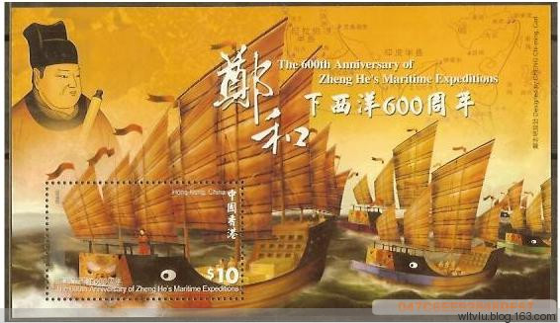
Zheng He’s seven voyages to the Western Seas
Zheng He (1371-1435)
a famous naval explorer of the Ming dynasty

Slide 24
Emperor Shun
舜帝
By mural painting from Han dynasty - Li Ung Bin, Outlines of Chinese History, Shanghai 1914, Public Domain, https://commons.wikimedia.org/w/index.php?curid=4297913
Notes:
Let us have a look at Emperor Shun.
Emperor Shun’s stepmother and stepbrother attempted to murder him many times, but he never held any grudges against them. Instead, he constantly reflected on himself and how he could do better in making his parents and stepbrother happy.
Eventually, he touched his stepmother and stepbrother as well as the community. He was later recommended to the emperor and ultimately Emperor Yao chose Shun as his successor.
People like Emperor Shun are called sages.

Slide 25
真正認識到一體是宇宙人生真相的人就是聖人，即回歸自性、明明德的人。
Notes:
In Chinese, a person who has truly recognised the oneness, the truth of life and the universe is called a ‘sage’.
They have returned to their self-nature and have recovered their innate virtue.
The Emperors Yao and Shun are sage Kings.

Slide 26
The Way of the great Emperors Yao and Shun was simply the practice of filial piety and love among siblings.
—— Mencius
堯舜之道，孝弟而已矣。
—— 《孟子·告子下》
Notes:
It is said in the teachings of Mencius that ‘The Way of the great Emperors Yao and Shun was simply the practice of filial piety and love among siblings.’
Our love and respect for our parents and siblings is elevated to love for all, then the world will naturally be at peace.

Slide 27
化敵為友
Notes:
There is an old Chinese saying, ‘Turn enemies into friends’.
How do we do to achieve this?

Slide 28
唯天下至誠為能化
《中庸》
Notes:
By moving others with our sincerity.
The Doctrine of the Mean says, ‘Only utmost sincerity can reform others.’ Utmost sincerity can nurture and touch all beings. It can touch heaven and earth and of course human beings.
What happens when we do not follow the teachings of the sages, and instead resort to competition or conflict to deal with problems?

Slide 29
冤冤相報，沒完沒了
Notes:
Well, we find ourselves in the situation of ‘an eye for an eye’, an endless cycle of retaliation. As a result, the conflict inevitably escalates, both parties are hurt and the problems remain unresolved.

Slide 30
中華優秀傳統文化的神奇作用就是能夠達到人與人之間的和諧。
Notes:
The magical effect of traditional Chinese culture is to bring about harmony among human beings.

Slide 31
在這個世界上
沒有我恨的人，
沒有我不能原諒的人，
沒有我不愛的人。
^{上}淨^{下}空老教授
Notes:
As the Venerable Master Chin Kung once said, ‘there is no one in the world that I hate, there is no one in the world that I cannot forgive, there is no one in the world that I do not love’.

Slide 32
Culturally prosperous 文化的興盛
The land of propriety 禮儀之邦
Khan of Heaven 天可汗
A universally recognised leader 王天下
Notes:
Therefore, all the golden ages in Chinese history were not only economically prosperous, but also culturally prosperous. It was traditional Chinese culture that enabled good governance of China in history.
This is why China has been known as ‘the land of propriety’ in the past and the Chinese emperors were respectfully called ‘Khan of Heaven’, which means ‘a universally recognised leader’ as they can set a good role model for others.
Love for one another, to the greatest extent, is global harmony. So, what does a harmonious world look like?

Slide 33
大道之行也，天下為公。
選賢與能，講信修睦，
故人不獨親其親，不獨子其子。
《禮記·禮運》
Notes:
It is said in the Book of Rites, ‘The world belongs to its people. In a harmonious world, the virtuous and the capable are chosen to be leaders; trust and good neighbourliness is promoted. All people love and respect their parents and children as well as the parents and children of others.

Slide 34
使老有所終，壯有所用，
幼有所長，矜寡孤獨廢疾者，皆有所養。
Notes:
As a result, the elderly are cared for, adults realise their full potential, and the children are raised with care. Widows, widowers, orphans and the childless, people with disabilities, and those with illness, are all well taken care of.’
Is such a world not ‘the Chinese dream’ that people in China today are pursuing?

Slide 35
大同世界
互助（老吾老以及人之老，
幼吾幼以及人之幼。）
互愛（四海之內皆兄弟）
孝悌

Slide 36
世界上一些有識之士認為，包括儒家思想在內的中國優秀傳統文化中蘊藏著解決當代人類面臨的難題的重要啓示。
—— 習主席
Notes:
This is why at the International Conference in Commemoration of the 2565th Anniversary of Confucius’s birthday held in 2014, President Xi of China said,
‘There are people with vision in the world who think that the rich traditional Chinese culture, including the notions of Confucianism, can inspire us to resolve the serious problems that humankind today is facing.’
President Xi’s words are not without basis.

Slide 37
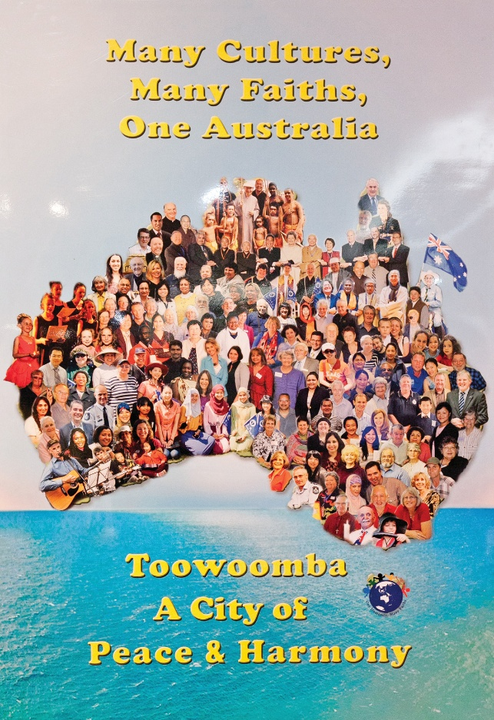
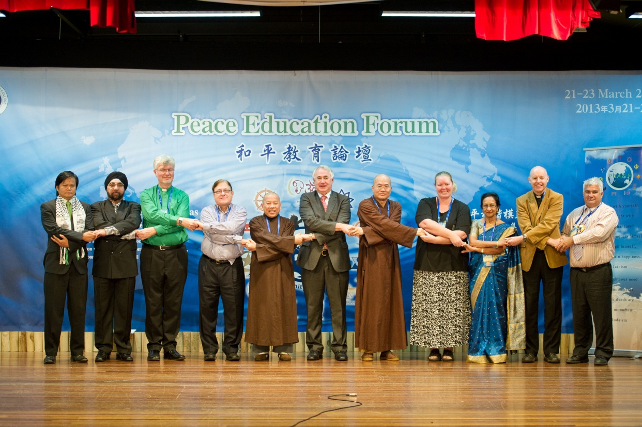
Faith leaders with the Mayor of Toowoomba (2013)
Notes:
In an increasingly diverse and divergent world, understanding the five relationships, and practising their related values, helps us resolve conflicts and differences from their roots. To enhance public confidence in peace and harmony, Venerable Master has been promoting interfaith and intercultural harmony, and has proved that the philosophy of Chinese traditional culture not only applies to a town in China, but also applicable to a multicultural cities outside of China, such as Toowoomba in Australia.

Slide 38
中國自古就提出了“國雖大，好戰必亡”的箴言。“以和為貴”“和而不同”“化干戈為玉帛”“國泰民安”“睦鄰友邦”“天下太平”“天下大同”等理念世代相傳。中國歷史上曾經長期是世界上最強大的國家之一，但沒有留下殖民和侵略他國的記錄。我們堅持走和平發展道路，是對幾千年來中華民族熱愛和平的文化傳統的繼承和發揚。
2014年3月在德國科爾伯基金會的演講

Slide 39
古往今來，中華民族之所以在世界有地位、有影響，不是靠窮兵黷武，不是靠對外擴張，而是靠中華文化的強大感召力和吸引力。我們的先人早就認識到“遠人不服，則修文德以來之”的道理。闡釋中華民族稟賦、中華民族特點、中華民族精神，以德服人、以文化人是其中很重要的一個方面。
（2014年10月15日習近平總書記在文藝工作座談會上的重要講話）

Slide 40
故亂國之主，
務於廣地，而不務於仁義，
務於高位，而不務於道德，
是捨其所以存，
而造其所以亡也。
《群書治要•文子》

Slide 41
2、天人合一
天人合一 與 可持續發展

Slide 42
夫大人者，
與天地合其德，
與日月合其明，
與四時合其序。
《群書治要•周易》

Slide 43
順天者存，
逆天者亡。
孟子

Slide 44
民吾同胞；
物吾與也。
張載
Notes:
Zhang Zai, “The Western Inscription,” in Wing-tsit Chan, trans., A Source Book in Chinese Philosophy (Princeton, N.J.: Princeton University Press, 1963), 497.

Slide 45
大人者，
以天地萬物為一體者也。
  王陽明
Notes:
Wang Yangming, “The Western Inscription,” in Wing-tsit Chan, trans., A Source Book in Chinese Philosophy (Princeton, N.J.: Princeton University Press, 1963), 659-660.

Slide 46
大人之能以天地萬物為一體也，非意之也，
其心之仁本若是。

Slide 47
是故見孺子之入井，而必有怵惕惻隱之心焉，是其仁之與孺子而為一體也；孺子猶同類者也，見鳥獸之哀鳴觳觫，而必有不忍之心，是其仁之與鳥獸而為一體也；鳥獸猶有知覺者也，見草木之摧折而必有憫恤之心焉，是其仁之與草木而為一體也；草木猶有生意者也，見瓦石之毀壞而必有顧惜之心焉，是其仁之與瓦石而為一體也。

Slide 48
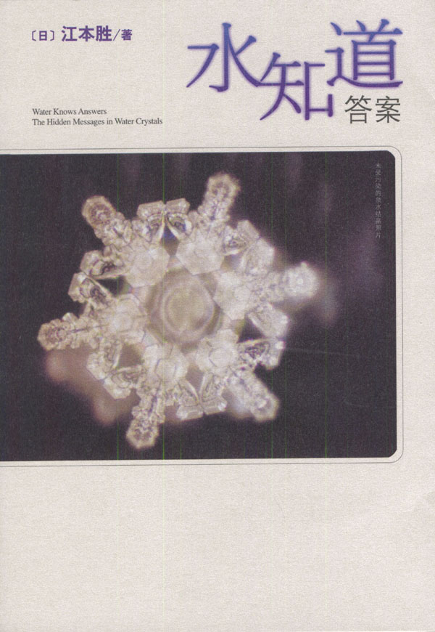

Slide 49
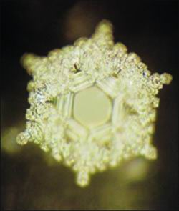
看过"爱与感谢"几个字的水所形成的结晶。这样的水结晶充满了喜悦，并形成 像盛开的鲜花一样的模样。

Slide 50
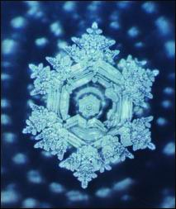
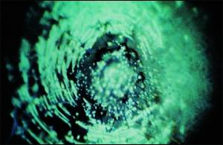
謝謝
混蛋

Slide 51
真正的風水在哪裡？

Slide 52
夫損人而自益，身之不祥也；
棄老而取幼，家之不祥也；
釋賢而任不肖，國之不祥也；
老者不教，幼者不學，俗之不祥也；
聖人伏匿，愚者擅權，天下不祥也。
《群書治要·孔子家語》

Slide 53
一切福田，不离方寸
福人居福地，福地福人居

Slide 54
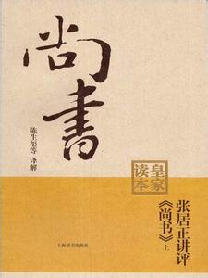
內作色荒，外作禽荒，
甘酒嗜音，峻宇雕牆，
有一於此，未或弗亡。
《群書治要•尚書》

Slide 55
布衣也，其友皆孝悌，純謹畏令，如此者，家必日益，身必日安，此所謂吉人也；
事君也，其友皆誠信有行好善，如此者，事君日益，官職日進，此所謂吉臣也；
人主也，朝臣多賢，左右多忠，主有失，敢交爭正諫，如此者，國日安，主日尊，天下日服，此所謂吉主也。
《群書治要•呂氏春秋》

Slide 56
巧奪天工

Slide 57
3、和而不同
  和而不同 與 合作共贏

Slide 58
萬物並育而不相害，
道並行而不相悖。
《中庸》

Slide 59
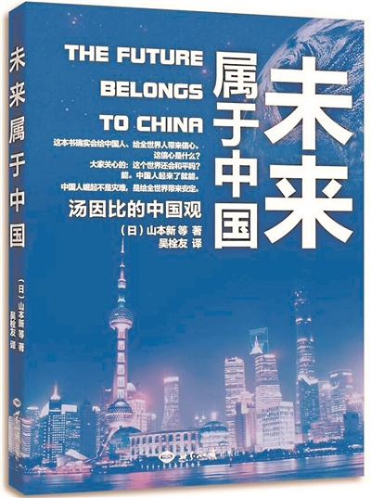
以中國為核心的東亞如果成為一體，這個東亞共同體將會成為未來世界的中堅力量。

Slide 60
